Slide 1
ServAlert
Chidinma Ejiofor, Jack DeGuglielmo

Slide 2
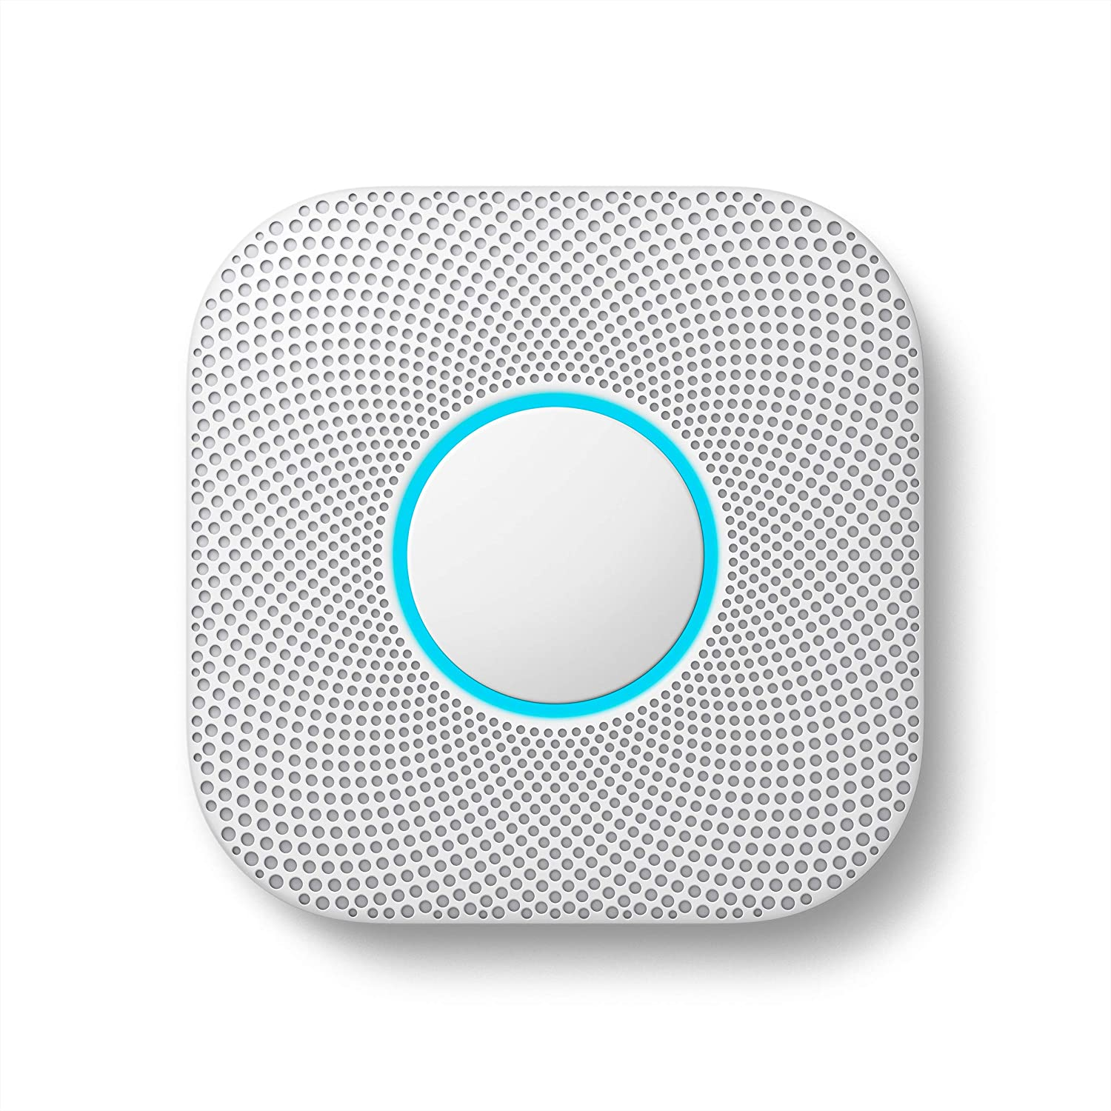
Problem Statement
Google Nest Protect is an IoT smoke detector
It measures carbon monoxide in the air via its sensors
Sending messages to your phone to alert users of smoke or fire
Google Nest Protect Costs a Total of 99$ not including alternate setups and additional products
In emergency situations like fires, safety monitoring systems must be robust to power outages, have a long battery life, and be responsive to homeowners.

Slide 3
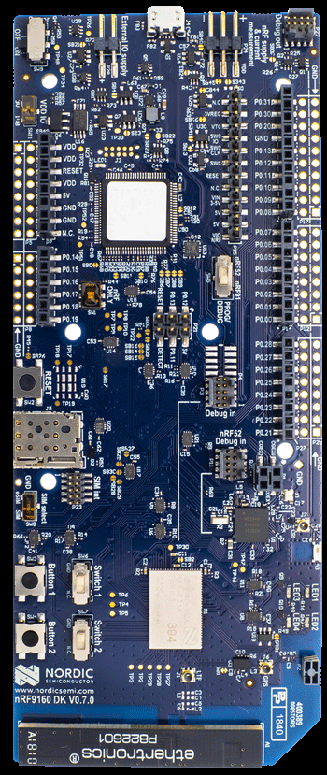
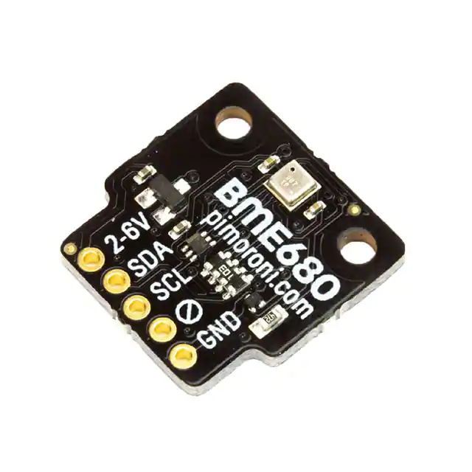
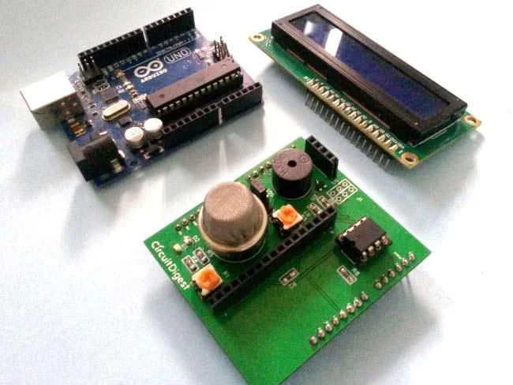
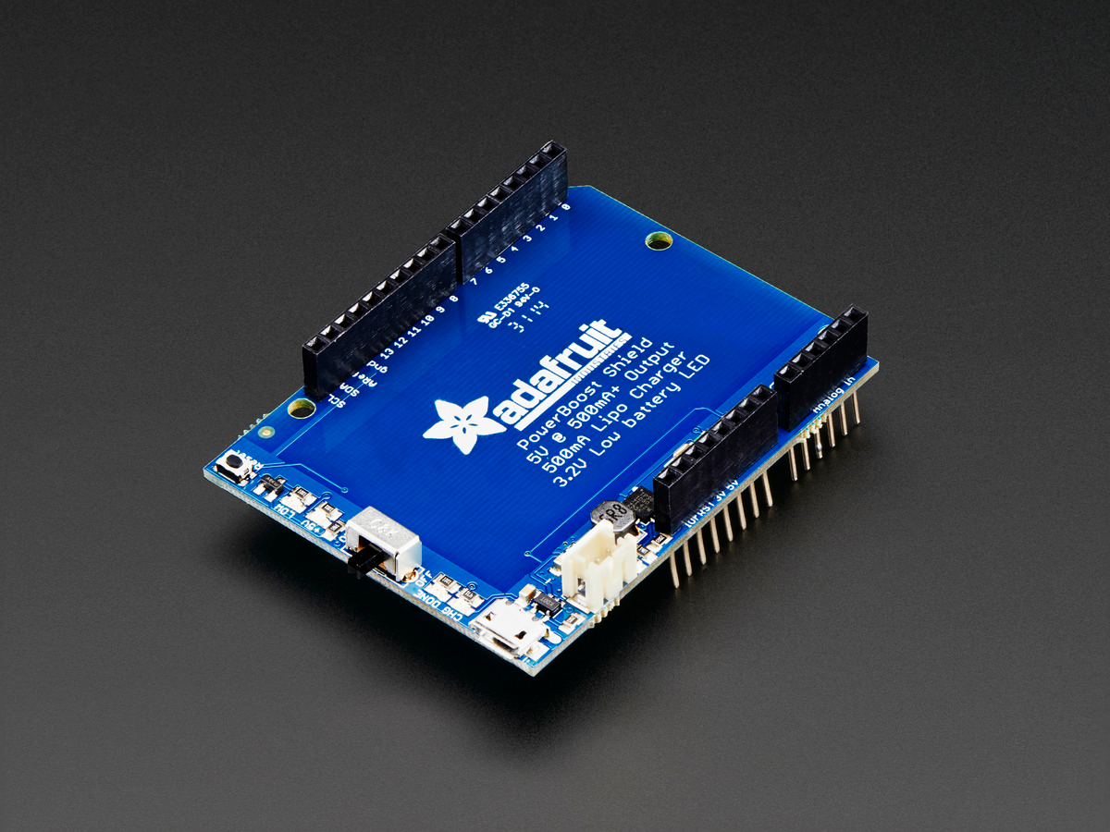

Hardware Implementation
Nordic nrf9160 Development Kit
Arduino MQ2 Smoke Detector Shield OR PIM357 (Pimoroni breakout for bme680 gas sensor)
Adafruit Battery Pack Shield
Twilio Super Sim

Slide 4
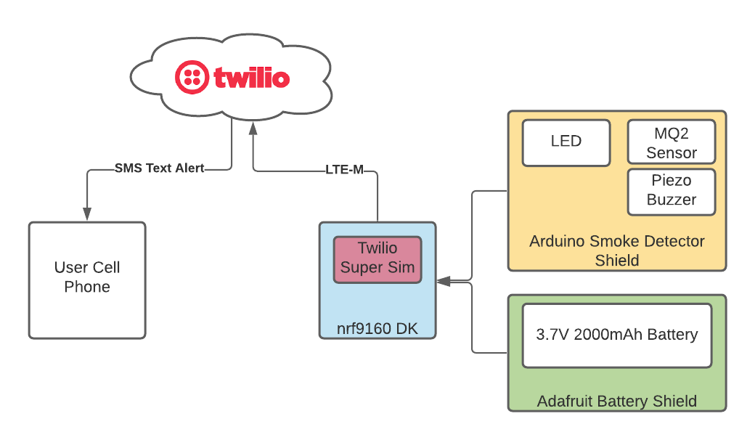
System Block Diagram

Slide 5
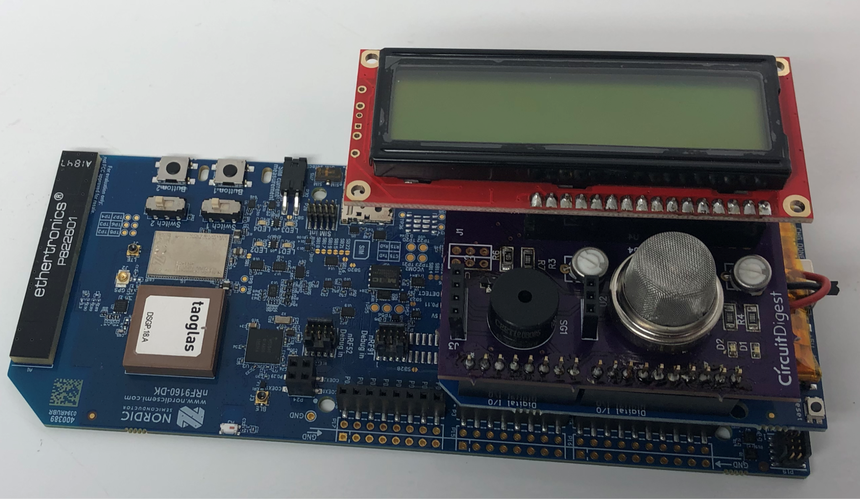
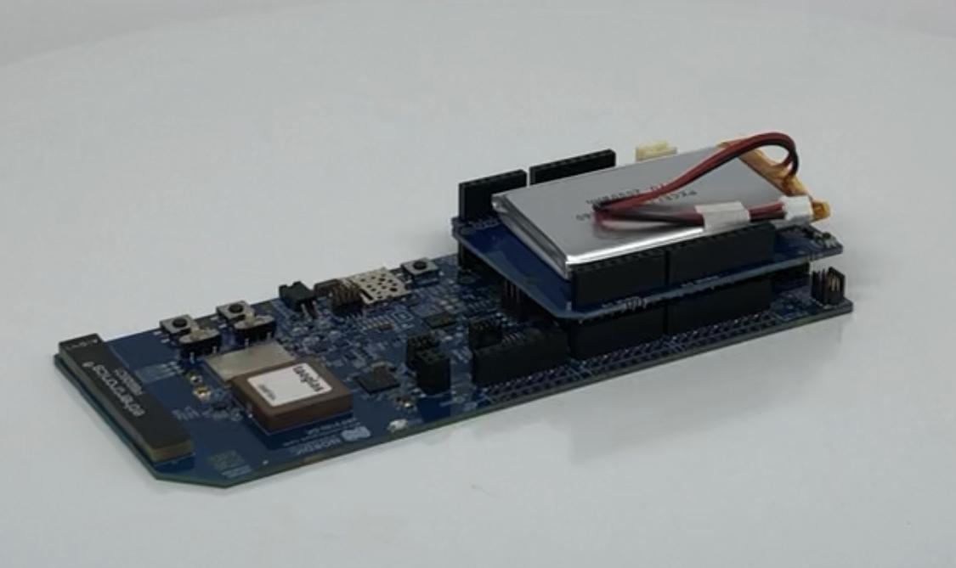

Slide 6
Evaluation Metrics
Battery life
Aiming for 3 months operation on backup battery
To test this we plan to model the energy consumption of the device for one week and predict the state of charge after 3 months
Responsiveness
How quickly will the device inform the user of an emergency?
To evaluate end to end delay, we will perform a mock emergency scenario and evaluate how quickly the device informs the user of smoke detection
Sensitivity
Because the distance from the smoke is relevant to how sensitive the device is, we plan to evaluate the detected smoke ppm at different distances from a smoke source.

